Slide 1
Rice Leaf Disease Detection
Vignesh P G, Abirami S, Keerthana S, Yashwanthram K A
344,348,349,370

Slide 2
Motivation
Economic Impact: Bacterial leaf blight (BLB) is one of the most serious diseases of rice, causing significant yield loss which can be up to 20-50% in susceptible rice varieties
Food Security: Rice is a staple food for over half of the world's population. The widespread occurrence of BLB disease not only threatens the livelihood of farmers but also poses a risk to food security
Challenges in Disease Management: BLB can spread rapidly under favorable conditions, and current management practices require timely and accurate detection to be effective

Slide 3
Challenges
Issues such as varied camera angles, distances, and occlusions can hinder accurate disease identification.
Traditional detection methods often miss the early stages of BLB due to symptoms being easily mistaken for other stresses like nutrient deficiencies.
Rice fields exhibit vast variability in terms of image capture conditions such as lighting and shadow effects.

Slide 4
Aim
computer vision (CV) techniques to significantly improve the accuracy and reliability of bacterial leaf blight detection in rice crops
Implement image processing operations to preprocess input images for optimal feature extraction, ensuring the CV model can handle real-world agricultural data effectively.
Provide a user-friendly solution (App) that empowers farmers with actionable insights for early disease intervention.

Slide 5
Addressing the Problem Statement with CV
Preprocessing Techniques: Utilize preprocessing steps like color normalization, contrast enhancement, and noise reduction to mitigate issues with image quality and lighting conditions.
Feature Enhancement: Apply edge detection and segmentation algorithms to highlight important features such as leaf shape and spots characteristic of BLB, making it easier for the model to classify disease presence.
Model Robustness: Train deep learning models using augmented datasets that include a variety of image conditions to ensure high performance despite the common challenges faced in field imagery such as occlusions and varying angles.

Slide 6
Implemented cv techniques
Noise Reduction (Gaussian blur)
Color Space Transformation
Histogram Equalization
Feature Extraction:
Edge Detection (Sobel, Canny)
Morphological Operations
(dilation, erosion,connectec components)
Region-based Segmentation
Model Development:
Convolutional Neural Networks (CNNs) for pattern recognition
Data Augmentation strategies to increase model generalizability
Model Optimization (e.g., hyperparameter tuning, regularization)

Slide 7
Texture Analysis (e.g., Gray Level Co-occurrence Matrix) Model Evaluation: Cross-validation for unbiased performance assessment Precision-Recall and ROC Curve analysis Confusion Matrix for detailed error analysis Field Testing results to validate model in real-world conditions Deployment: Integration into mobile applications for on-the-spot detection Cloud-based processing for resource-intensive computations User Interface design focusing on ease-of-use for farmers Continuous Learning setup to refine model with new data over time
To be implemented

Slide 8
Dataset Details
Source: Kerala Agricultural University Rice Field Dataset
: Kaggle https://www.kaggle.com/datasets/vbookshelf/rice-leaf-diseases/data
Focus: Bacterial Leaf Blight (BLB) disease
The dataset consists of 5 stage images of rice leaves, encompassing healthy leaves and leaves infected with BLB at various stages.
The images were captured under controlled conditions to ensure consistency.

Slide 9
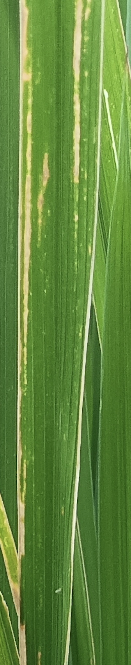
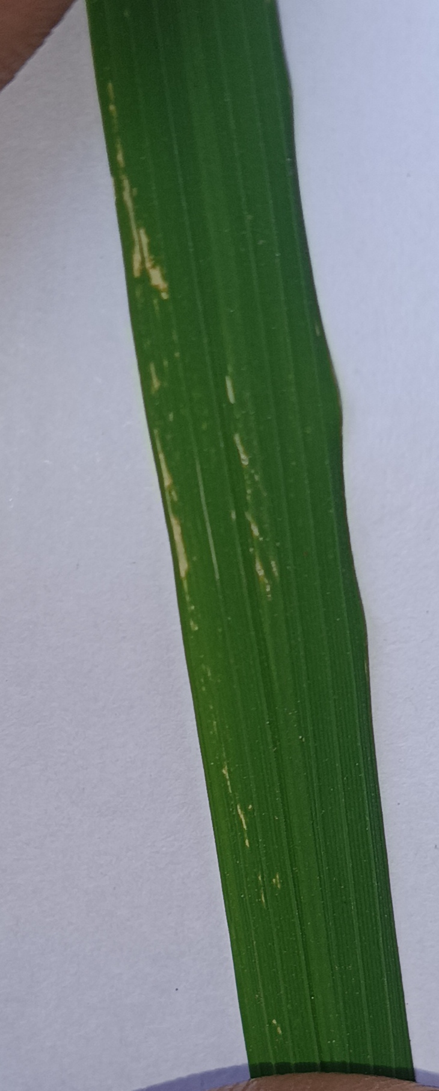
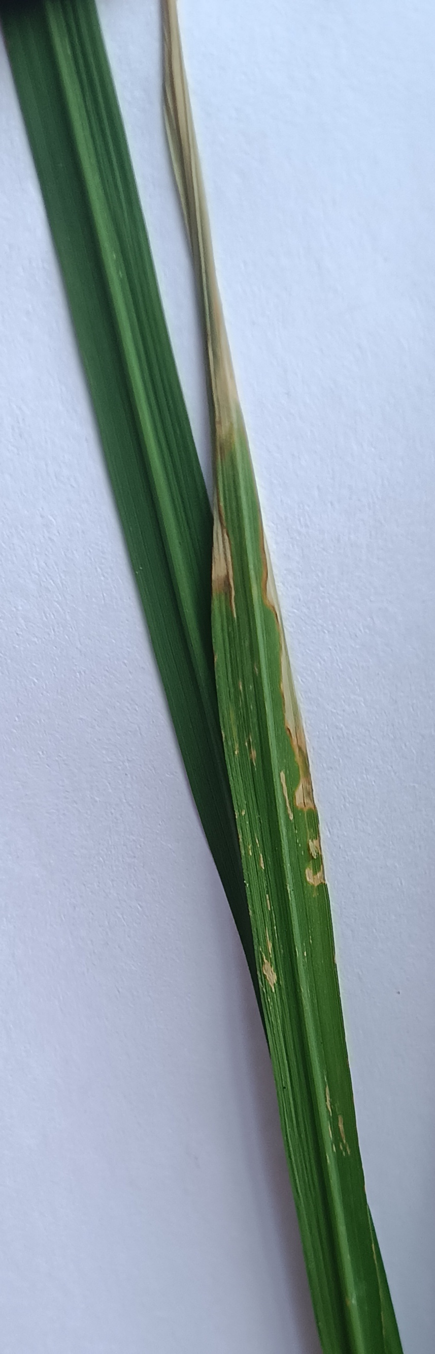
Sample images

Slide 10
Literature Review
Sharma, Mayuri et al. “Identification of rice leaf diseases and deficiency disorders using a novel DeepBatch technique.” Open life sciences vol. 18,1 20220689. 28 Aug. 2023, doi:10.1515/biol-2022-0689
The proposed solution introduces DeepBatch, a novel DL framework that enhances rice disease diagnosis. It combines precise DL-based segmentation with a bitwise logical AND operation, followed by a transfer learning-driven classification, effectively identifying common diseases and nutrient deficiencies in rice plants.
Hasan, M.M.; Uddin, A.F.M.S.; Akhond, M.R.; Uddin, M.J.; Hossain, M.A.; Hossain, M.A. Machine Learning and Image Processing Techniques for Rice Disease Detection: A Critical Analysis. Int. J. Plant Biol. 2023, 14, 1190-1207. https://doi.org/10.3390/ijpb14040087
machine-learning-driven system for early detection of rice diseases, utilizing image acquisition, preprocessing, and segmentation to facilitate feature extraction and classification, improving the accuracy and speed of disease diagnosis in rice cultivation.

